Slide 1
Statistical Modeling of Airbnb Listings in New York City
AU24 GTDA 5401
Project 2
Lisa Siefker
Jiwon Hong (statistical analysis)

Slide 2
Data Summary
Dataset: Airbnb in NYC*
Dimensions: 20,758 rows x 22 variables Key Variables:
Neighborhood Group (5 unique groups)
Neighborhood (219 unique neighborhoods)
Price per night
Rating (average total rating)
Number of Bedrooms
Number of Bathrooms
* https://www.kaggle.com/datasets/vrindakallu/new-york-dataset

Slide 3
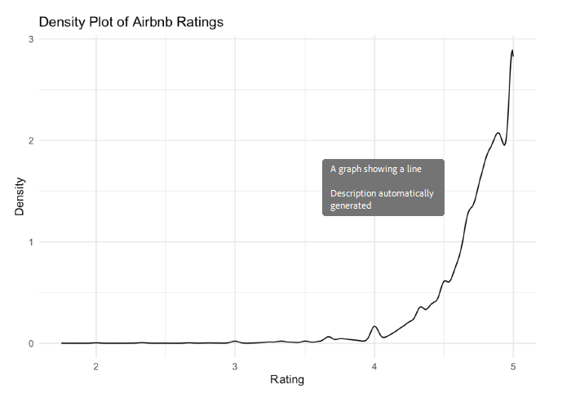
Question 1. Can you predict an Airbnb rating based on price per night and borough?

Slide 4
Question 1. Can you predict an Airbnb rating based on price per night and borough?
Methodology: Linear Regression
Used to model relationship between an independent variable (response) and one or more independent variables (predictors)
Minimizes squared differences between observed and predicted values
Predict rating based on price per night and borough

Slide 5
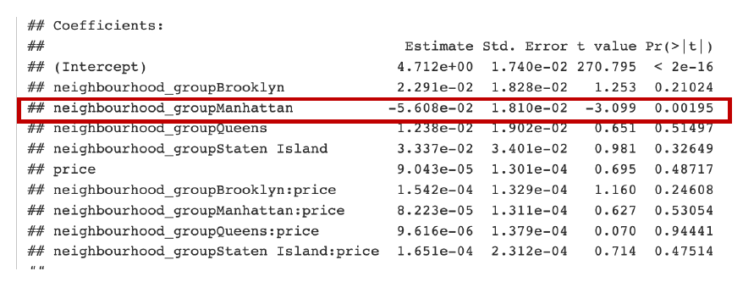
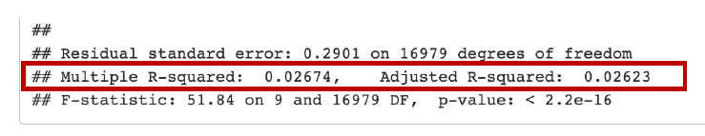
Question 1. Can you predict an Airbnb rating based on price per night and borough?

Slide 6
Question 1. Can you predict an Airbnb rating based on price per night and borough?
Prediction Feasibility:
While the model can technically predict ratings, its explanatory power is very weak, as shown by the low R²
Most of the variation in Airbnb ratings is not captured by price, borough, or their interaction
Key Insights:
Price and neighborhood do not strongly influence Airbnb ratings based on this model
Manhattan Airbnbs have slightly lower ratings than the reference group, but this difference is minimal

Slide 7
Question 2. Can you predict the price per night of an Airbnb based on borough and number of bedrooms?
Methodology: Linear Regression with Log Transformation
For variables like price, which have a skewed distribution, applying a log transformation can stabilize variance and improve model performance.
In this case, we apply a log transformation to price before fitting the linear regression model to predict it from other variables.

Slide 8
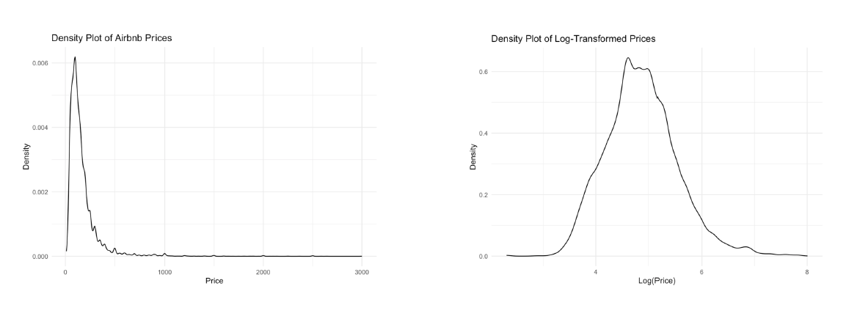
Question 2. Can you predict the price per night of an Airbnb based on borough and number of bedrooms?

Slide 9
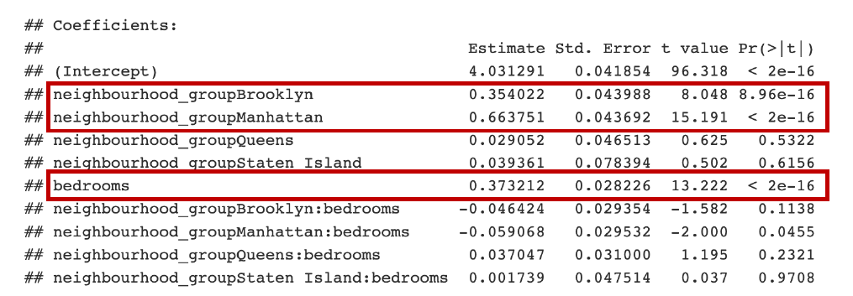
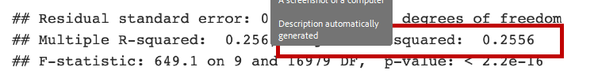
Question 2. Can you predict the price per night of an Airbnb based on borough and number of bedrooms?

Slide 10
Question 2. Can you predict the price per night of an Airbnb based on borough and number of bedrooms?
Prediction Feasibility:
The model can moderately predict the log-transformed price per night of an Airbnb based on borough and the number of bedrooms
The predictions for actual prices are imprecise
Key Insights:
Airbnbs in Brooklyn and Manhattan tend to have significantly higher prices than the baseline group
Additional bedrooms lead to higher prices overall

Slide 11
Question 3. Is there a significant difference in average price between Manhattan and Brooklyn Airbnbs that have 2 bedrooms and 1 bathroom?
Methodology: Two-sample t-test
Used to compare the means of two groups to determine if they are significantly different
Due to unequal sample sizes, the Welch t-test is used (var.equal = FALSE), which does not assume equal variances)
Here, we perform a two-sample t-test to compare average price between Manhattan and Brooklyn Airbnbs with 2 bedrooms and 1 bathroom

Slide 12
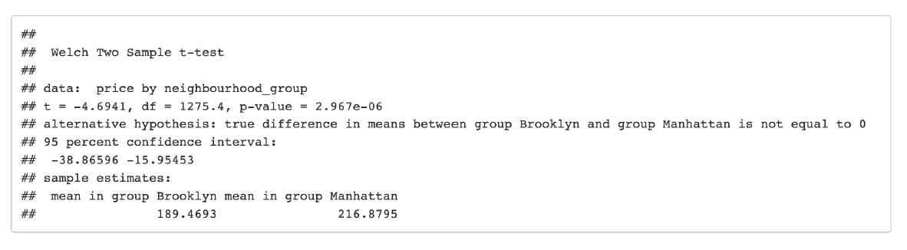
Question 3. Is there a significant difference in average price between Manhattan and Brooklyn Airbnbs that have 2 bedrooms and 1 bathroom?
Answer: Yes, there is a significant difference in average price between Manhattan and Brooklyn Airbnbs with 2 bedrooms and 1 bathroom. Manhattan Airbnbs are, on average, $27.41 more expensive than those in Brooklyn.

Slide 13
Question 4. Is there a significant difference in average price between Airbnbs that have average reviews that are more than 4 stars and Airbnbs that have average reviews that are less than 4 stars?
Methodology: Two-sample t-test
Used to compare the means of two groups to determine if they are significantly different
Due to unequal sample sizes, the Welch t-test is used (var.equal = FALSE), which does not assume equal variances)
Here, we perform a two-sample t-test to compare average prices between Airbnbs with ‘above 4 star’ and ‘below 4 star’ average reviews

Slide 14
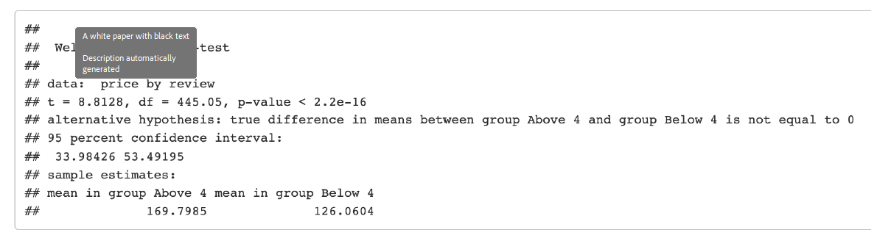
Question 4. Is there a significant difference in average price between Airbnbs that have average reviews that are more than 4 stars and Airbnbs that have average reviews that are less than 4 stars?
Answer: Yes, there is a significant difference in average price between Airbnbs that have average reviews above 4 stars and those below 4 stars. Airbnbs with reviews above 4 stars are, on average, $43.74 more expensive than those with reviews below 4 stars.

